Slide 1
So....you need to do some research or find a book?
How do you find what you're looking for?

Slide 2
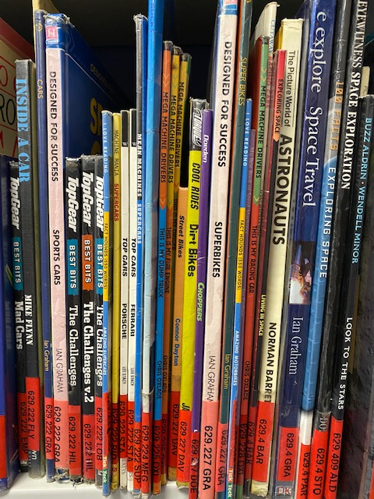
The Dewey Decimal System

Slide 3
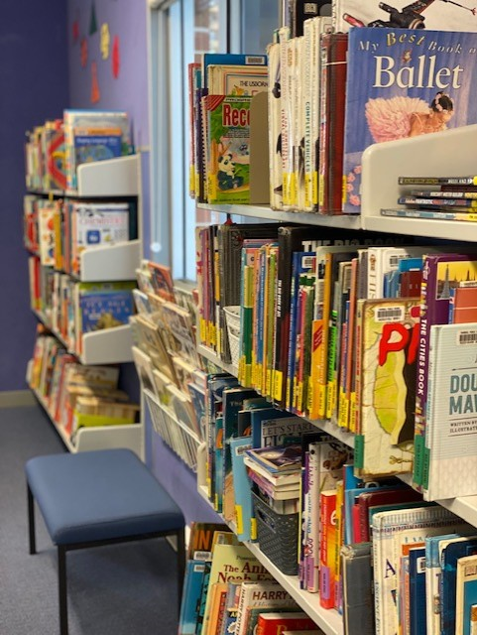
Our library has a system in place to help you find what you need. In fact, around 200,000 libraries in 135 countries around the world use this system meaning you could visit a library in Perth, New York or Paris and easily find your favorite book because it would shelved using the same system. So learn the Dewey Decimal System and you've got it covered.

Slide 4
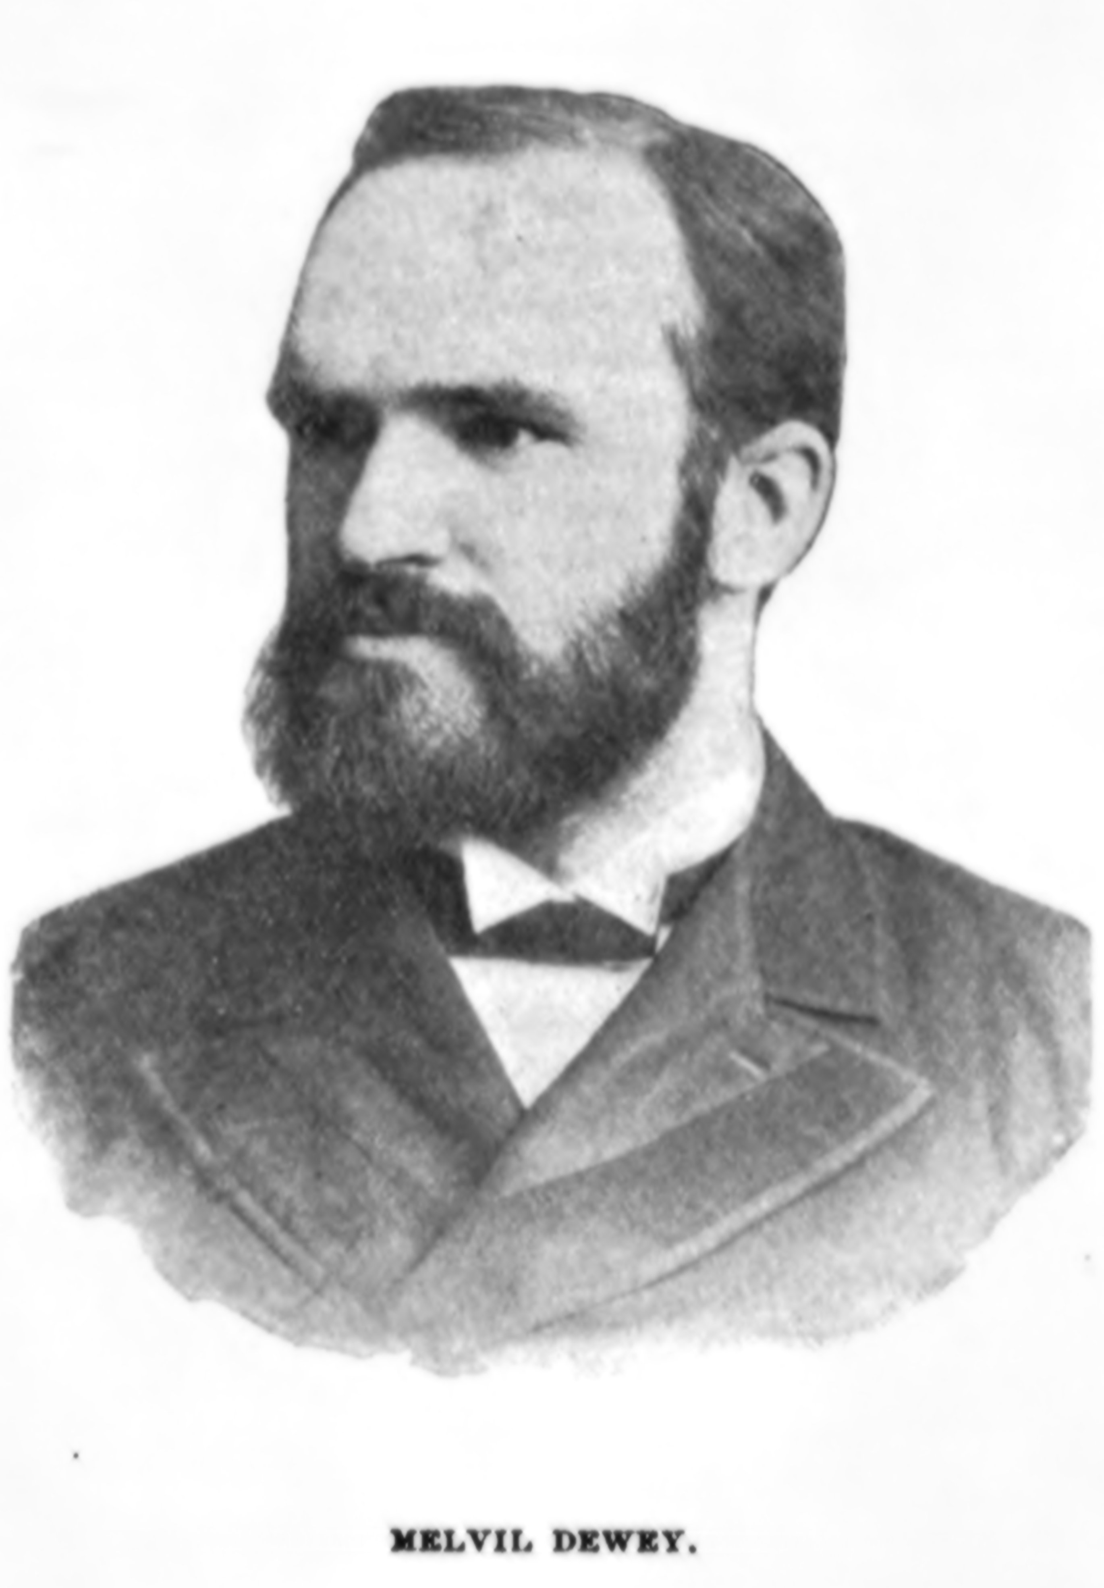
Melvil Dewey invented the Dewey Decimal System to help students and people find the books they needed. It was so good when it was invented in 1876 that it has lasted over 140 years! It is still the system that all libraries use to organise their books.

Slide 5
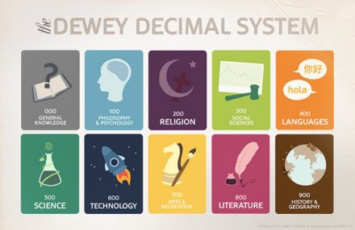
Melvil Dewey decided to put books into 10 different categories and he gave each category a number in the hundreds – from the 000's to the 900's.

Slide 6
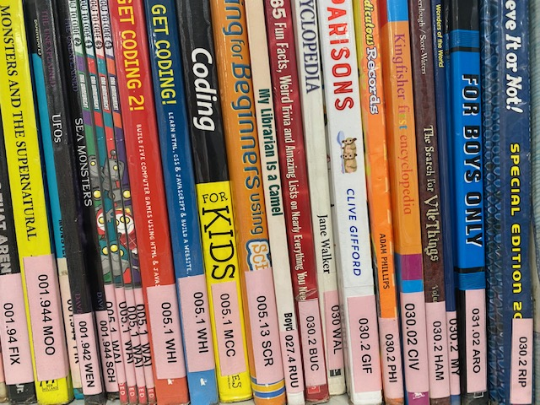
000's
General knowledge
and fun facts
Guinness World Records
Coding
UFO’s
Supernatural

Slide 7
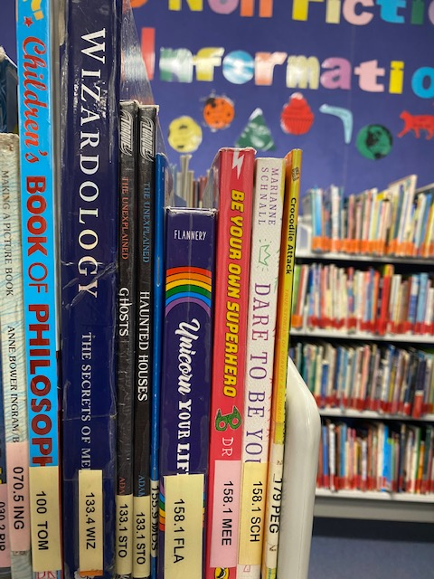
100's
Philosophy & Psychology
Wellness books
Life's big questions
Ghosts

Slide 8
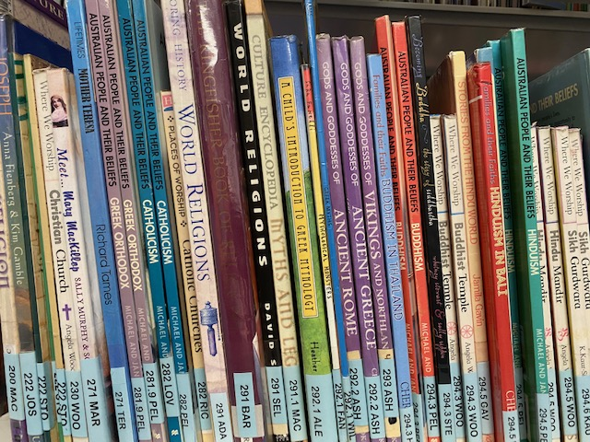
200's
Religion & Dreamtime
World religions
Dreamtime Stories

Slide 9
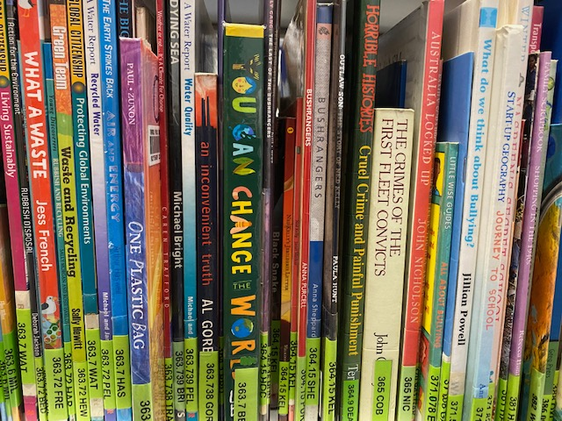
300's
Sciences &
Social Sciences
Climate Change
Recycling
Folk Tales
Fairy Tales
First Nation Peoples
Natural Disasters

Slide 10
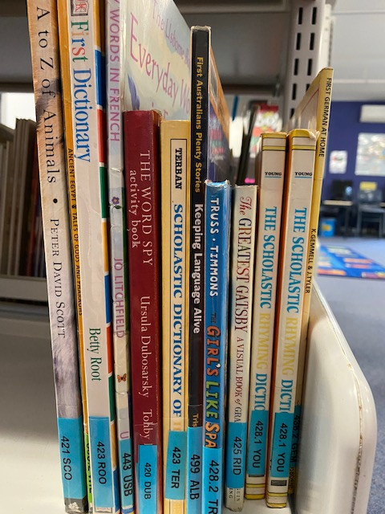
400's
Languages
Learn a foreign language
Grammar

Slide 11
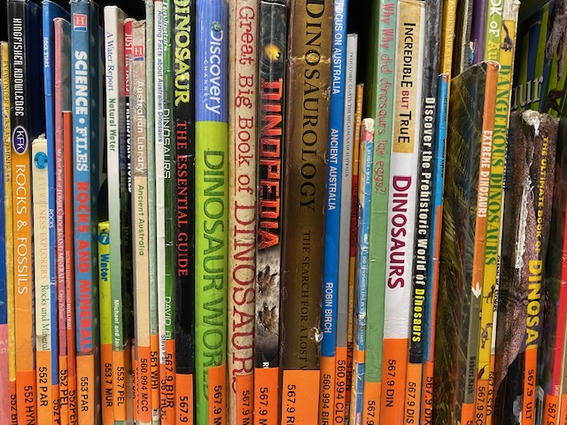
500's
Natural Sciences &
Mathematics
Space
Weather
Rocks and Crystals
Dinosaurs
Animals
Plants
Sharks

Slide 12
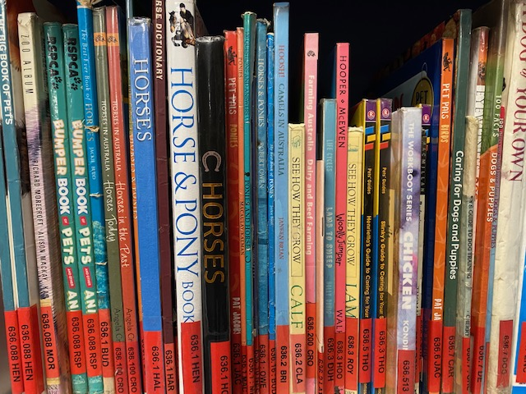
600's
Technology
The human body
Pets
Cook Books
Cars
Transport

Slide 13
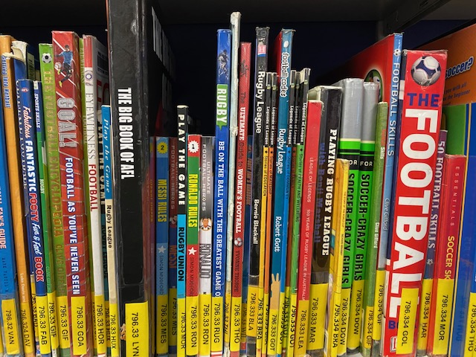
700's
Arts & Recreation
Sport
Craft books
Art books
How to Draw
Minecraft

Slide 14
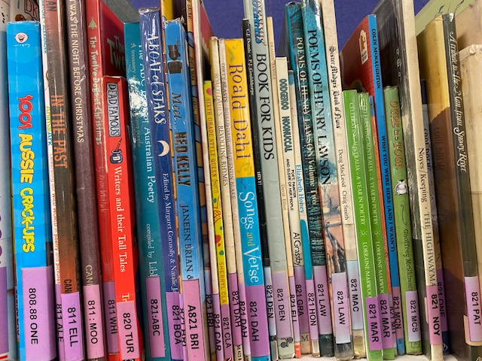
800's
Literature & Poetry
Jokes
Poetry
Movies

Slide 15
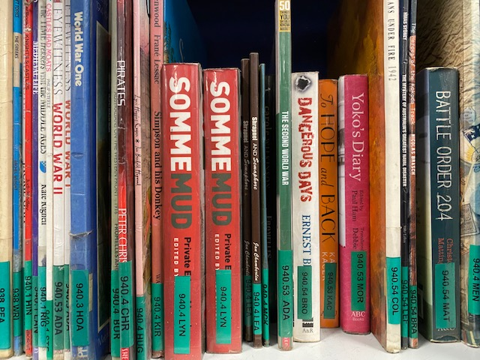
900s
History, Geography,
Biographies
Australian history
World history
Pirates
The Titanic
Atlases
Country-specific books
War history
Egypt

Slide 16
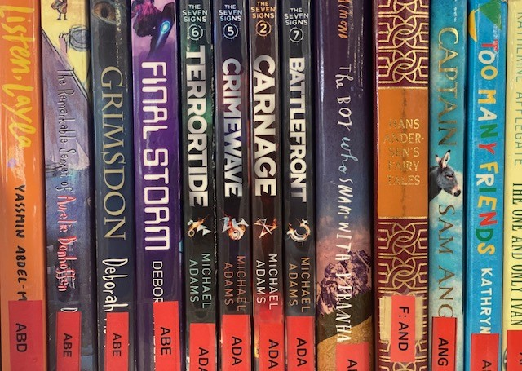
Fiction is organised according to the author's last name. For example, Aaron Blabey, the author of Pig the Pug and Bad Guys, has the spine label of ‘BLA’ for BLAbey. If you were an author, what would your spine label be?

Slide 17
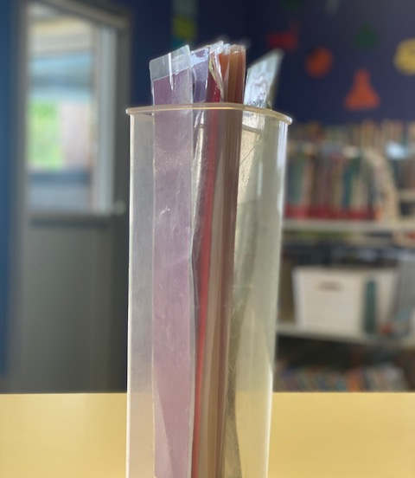
When we use the library, there are a couple of things to remember – Just as you like going to the shelf and finding what you want, so do other students. For this reason, it is important to put books back where you found them. That way, everyone can find what they need. In this library, we have shelf markers. When taking a book of the shelf to look at, replace it with a shelf marker. Either borrow the book or return the book to it back where the shelf marker is. If you’re not sure, ask Mrs Engelen or leave the book flat on a shelf. If you forget to remove the shelf marker, it doesn’t matter.

