Slide 2
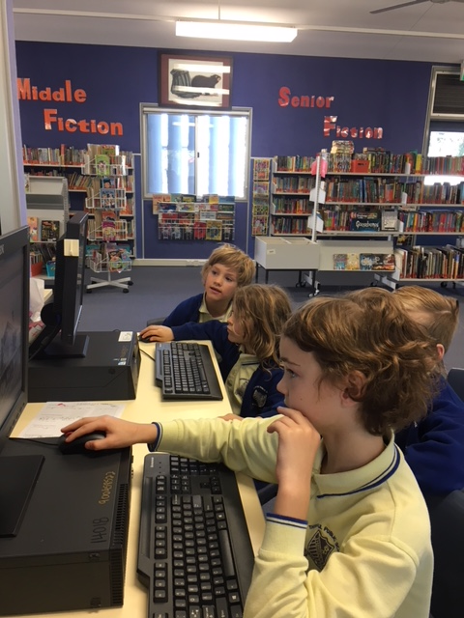
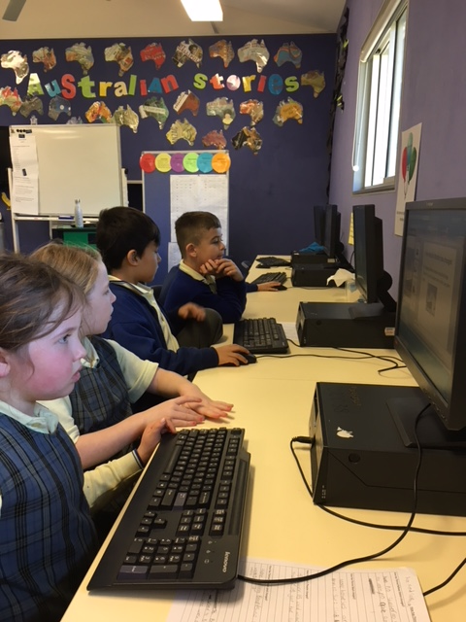
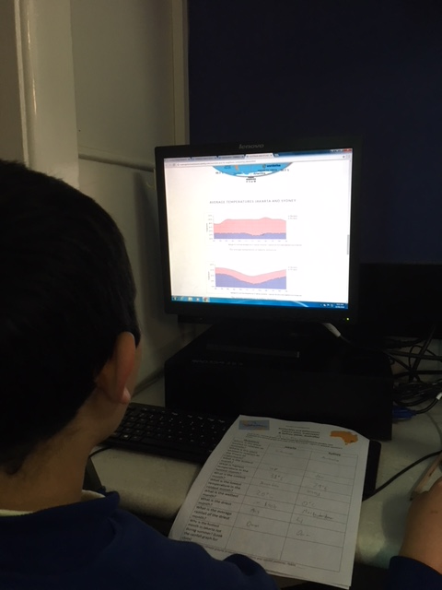
The difference between Digital Literacy and Information Literacy
Notes:
Being digitally literate far surpasses the basic literacy skill of reading, writing, listening and speaking. People can now also create, work, share, socialise, research, play, collaborate, communicate and learn. “Digital literacy looks beyond functional IT skills to describe a richer set of digital behaviours, practices and identities. What it means to be digitally literate changes over time and across contexts, so digital literacies are essentially a set of academic and professional situated practices supported by diverse and changing technologies.” https://getahead.tees.ac.uk/Pages/Digital-literacy.aspx
Discuss – technologies become obsolete so we students must develop the skills to navigate the internet
What is Inf lit?
What is dig

Slide 3
Defining
What do I really want to find out?
Assessing
What did I learn from this?
Locating
Where can I find the information I need?
The Information Skills Process
(ISP)
Presenting
How can I present this information?
Selecting
What information do I really need?
Organising
How can I use this information?

Slide 4
Functional Skills
Creativity
E-safety
Effective communication
Digital Literacy
Critical thinking and evaluation
The ability to find and select information
Cultural and social understanding
Collaboration

Slide 5
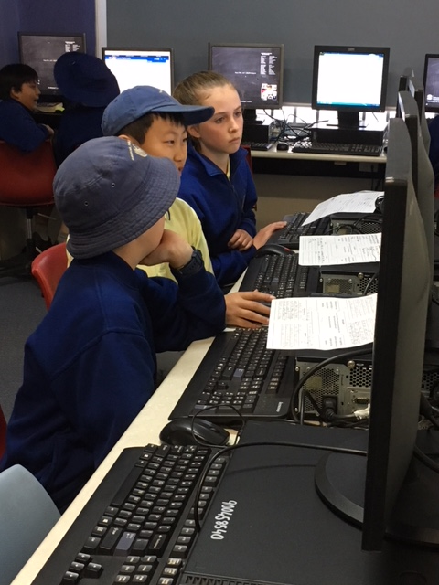
What does digital literacy look like in primary schools?
Notes:
In primary school, of course, we need to begin with the basics. When using the internet, students need to learn how to locate and select material – how to use browsers, hyperlinks and search engines and so on. As with print, they also need to be able to evaluate and use information critically if they are to transform it into knowledge, This means asking question about the sources of that information, the interests of its producers, and the ways in which it represents the world
While information literacy will be explicitly taught from year 1, digital literacy will be touched upon in almost every lesson from Stage 2. This can take the form of talking about the ads, looking at who created the site and how their beliefs may bias the information.

Slide 6
Information literacy is always taught inline with the school scope and sequence to reflect and complement learning being done in the classroom.

Slide 7
Stage 1
Explicit teaching of ICT skills
Year 1
Logging onto computer
Logging into their student portal and opening Oliver
Opening an application like Word or PowerPoint
Keyboard skills
Typing simple teacher-provided information
Source relevant images using keywords
Copying images into document
Saving in correct location
Year 2
Developing library skills(About 4 lessons). Understanding Dewey. Searching for titles on Oliver and then finding the book on the shelf, and using shelf-markers in NF.
Subsequent lessons, students to engage in the same project as Year 1. As their ICT skills are more developed they quickly catch up

Slide 8
Stage 2
Continuation of explicit teaching of ICT skills
Logging on to Student Portal and Oliver
Completion of booklet using online teacher-provided information
Define questions inline with research topic
Identifying keywords to use to research the question
Researching question and recording answers
Typing information into PowerPoint
Using keywords, sourcing relevant images to support text
Saving document in correct location

Slide 9
Stage 3
Demonstration
As a class define a set of research questions that are interesting and researchable
Demonstrate developing a set of keywords to research the questions
Demonstrate how to open links in a new tab
Demonstrate the criteria used to eliminate websites – excessive advertising, unsuitable information, disorganised ordering of information
Students to use 2 (definitely no more than 3 websites)
Demonstrate where the document is to be saved

Slide 10
DIGITAL LITERACY
Notes:
While information literacy will be explicitly taught from year 1, digital literacy will be touched upon in almost every lesson from Stage 2. None of the skills we teach should be taught in isolation – there is just not enough time. Rather, each time a skill is being taught/practiced the teacher introduction should include some of the wider issues in the discussion. For example, when demonstrating using keywords to conduct a search, as a class critique the websites being assessed. Why is the website suitable/unsuitable. This could be something as simple as the amount or type of advertisement present on the site, or the format or presentation of the information. Discussion of the website advertising could be discussed –
1. Why has someone paid to put their ad there?
2. Do we think that the ad impacts the information on the site?
3. Does it make us reconsider using that website?

Slide 11
Website Evaluation: Critical thinking
Critical evaluation of everything they hear and see.
Evaluating the credibility of the writer
Avoiding websites with excessive advertising
Confirming validity of information by cross referencing
Notes:
The Web allows anyone to post any kind of information on a website.
Information may not have been reviewed or edited
Possible bias – does the writer have an agenda

Slide 12
Critical thinking
What are we giving up to get something for nothing?
Notes:
Each year in term 4, the library program addresses digital citizenship and digital safety.
Students need to be aware of the information they give away when they sign up for something free on the internet. I want them to think about how organisations such as Facebook, Snapchat, Instagram and Google/Gmail pay for the staff and infrastructure to maintain these services. Look at some of the terms and conditions you are asked to agree to – why are they usually so long? Look at the use of cookies. How is it that whenever I get online I get adds for online shoe shops?

Slide 13
E-Safety: Staying safe online
Being protective of your online profile – your digital footprint lasts forever
Never give out your details – full name, school name, address or anything that will
How do companies target you online? Understanding cookies and the power of apps such as Siri.
Understanding that you don’t know who you are communicating with online

Slide 14
Digital Citizenship
What behaviour is unacceptable online
Who can you go to if you are worried about something you’ve seen
Being a kind, responsible digital citizen.
What to do if you, or you know someone who is being bullied online
Gaming etiquette

